Slide 1
Introduction to Machine Learning and Deep Learning
Name: Xi Chenyang
Mentor: Liu Xinfu
Contact Information: caralhsi@gmail.com

Slide 2
Contents
What is Machine Learning Doing?
Learning map of Machine Learning
Regression Problem
Linear Regression
Nonlinear Regression: Deep Learning

Slide 3
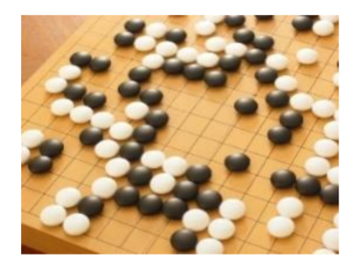
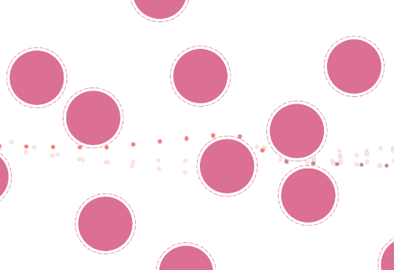
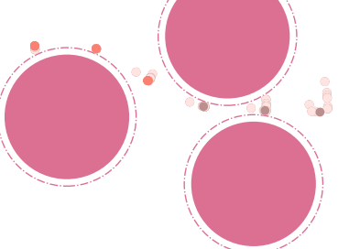


Machine Learning $≈$ Looking for a Function
Playing Go
$f($ $)=$ “5-5” (next move)
Control a Robot
$f($ $)=u1, u2, …$ (next control signals)
Notes:
机器学习到底在做什么 可以做什么？

Slide 4
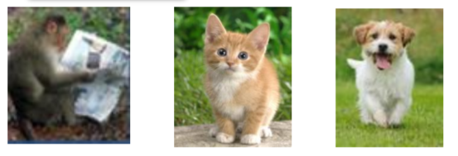
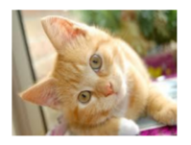
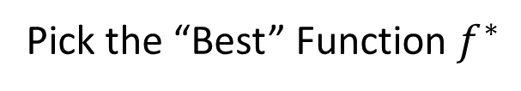

Framework of Machine Learning
Training
Testing
Model
A set of function
“cat”
Pick the “Best” Function $f^{∗}$
Goodness of function f
Using $f^{∗}$
Training Data
“monkey” “cat” “dog”
Notes:
机器学习一般是怎么样“学”的
Suppose we are tackling with am image recognition task

Slide 5
Machine Learning is very simple
Step 1: define a set of function
Step2: goodness of function
Step3: pick the best function
Notes:
总结一下就是分三步: 所有可能的模型，定义什么样的模型是一个好模型， 想办法找到最好的那个

Slide 6

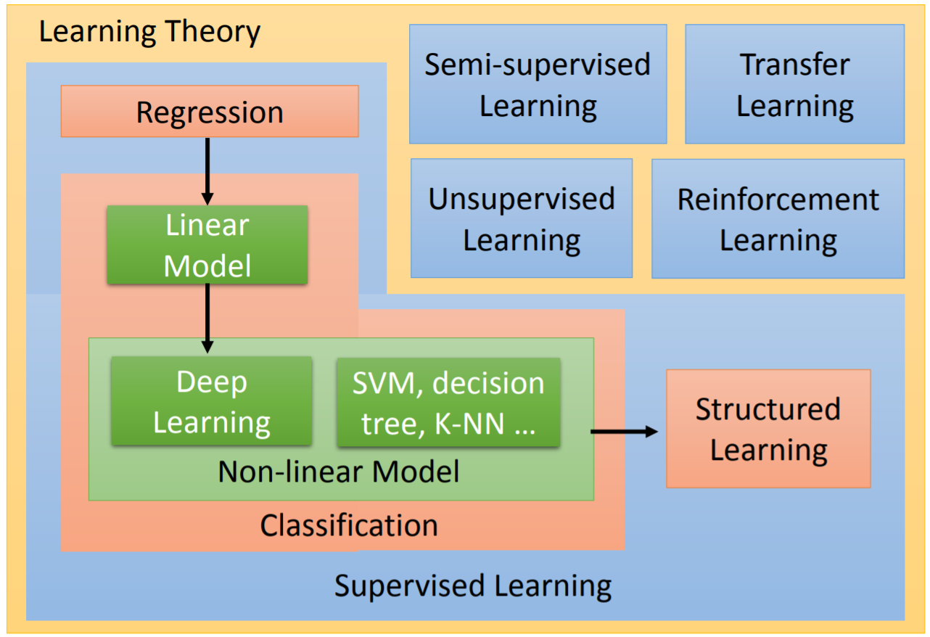
Learning Map
Notes:
不同性质场景对应不同的方法
不同的任务对应不同的算法
每种回归、分类或是结构性表达都可以用线性模型、非线性模型

Slide 7
Regression Problem
Linear regression
Trivial
Use Deep Learning to solve nonlinear regression
Powerful Tool

Slide 8
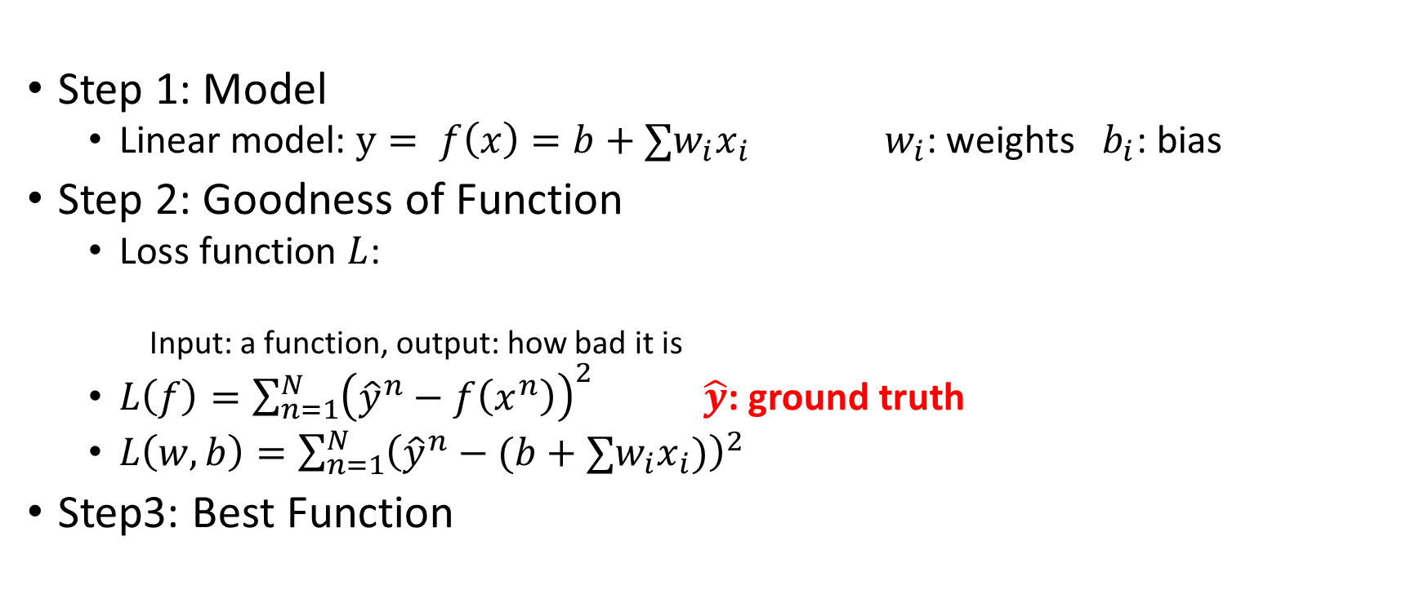
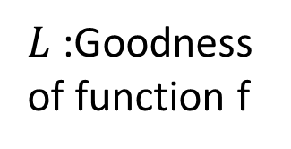
Linear Regression
A set of function
Step 1: Model
Linear model: $y= f\left(x\right)=b+∑w_{i}x_{i}$ $w_{i}$: weights $b_{i}$: bias
Step 2: Goodness of Function
Loss function $L$:
Input: a function, output: how bad it is
$L\left(f\right)=\sum_{n=1}^{N}{{\left({\hat{y}}^{n}−f\left(x^{n}\right)\right)}^{2}}$ $\hat{y}$: ground truth
$L\left(w, b\right)=\sum_{n=1}^{N}{{\left({\hat{y}}^{n}−(b+∑w_{i}x_{i})\right)}^{2}}$
Step3: Best Function
$L$:Goodness of function f
Training Data

Slide 9
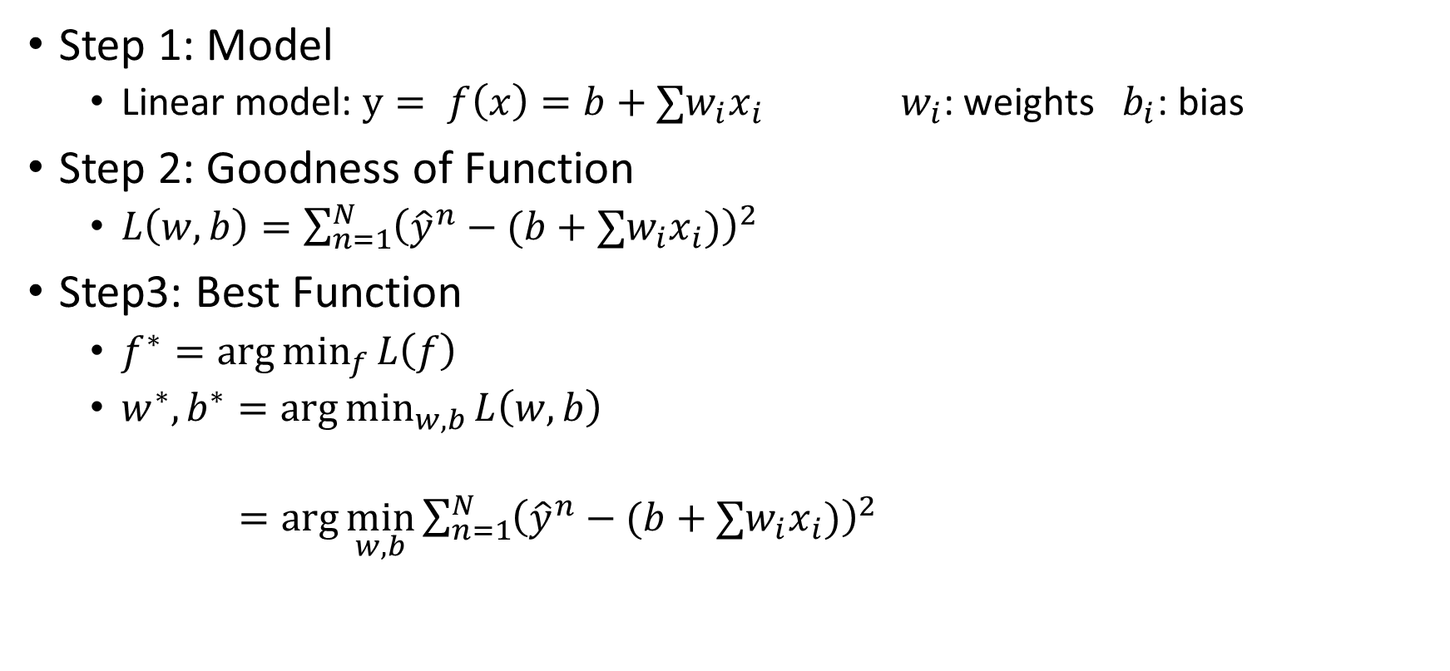
Linear Regression
Step 1: Model
Linear model: $y= f\left(x\right)=b+∑w_{i}x_{i}$ $w_{i}$: weights $b_{i}$: bias
Step 2: Goodness of Function
$L\left(w, b\right)=\sum_{n=1}^{N}{{\left({\hat{y}}^{n}−(b+∑w_{i}x_{i})\right)}^{2}}$
Step3: Best Function
$f^{∗}=\arg{\min_{f}{L\left(f\right)}}$
$w^{∗},b^{∗}=\arg{\min_{w, b}{L\left(w, b\right)}}$
$=\arg{\min_{w, b}{\sum_{n=1}^{N}{{\left({\hat{y}}^{n}−(b+∑w_{i}x_{i})\right)}^{2}}}}$
Gradient Descent

Slide 10
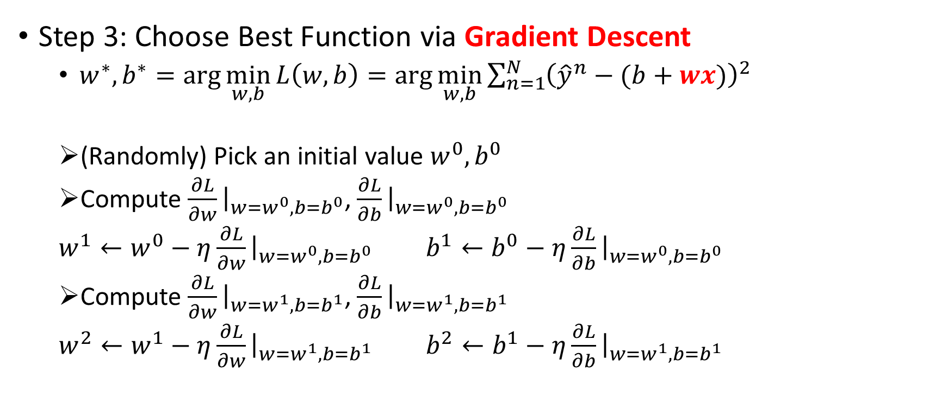
Linear Regression
Step 3: Choose Best Function via Gradient Descent
$w^{∗},b^{∗}=\arg{\min_{w, b}{L\left(w, b\right)}}=\arg{\min_{w, b}{\sum_{n=1}^{N}{{\left({\hat{y}}^{n}−(b+wx)\right)}^{2}}}}$
(Randomly) Pick an initial value $w^{0}, b^{0}$
Compute $\frac{∂L}{∂w}{\left.​\right|}_{w=w^{0}, b=b^{0}}$, $\frac{∂L}{∂b}{\left.​\right|}_{w=w^{0},b=b^{0}}$
$w^{1}←w^{0}−η\frac{∂L}{∂w}{\left.​\right|}_{w=w^{0}, b=b^{0}}$ $b^{1}←b^{0}−η\frac{∂L}{∂b}{\left.​\right|}_{w=w^{0}, b=b^{0}}$
Compute $\frac{∂L}{∂w}{\left.​\right|}_{w=w^{1}, b=b^{1}}$, $\frac{∂L}{∂b}{\left.​\right|}_{w=w^{1},b=b^{1}}$
$w^{2}←w^{1}−η\frac{∂L}{∂w}{\left.​\right|}_{w=w^{1}, b=b^{1}}$ $b^{2}←b^{1}−η\frac{∂L}{∂b}{\left.​\right|}_{w=w^{1}, b=b^{1}}$

Slide 11
Use Deep Learning to solve nonlinear regression
Ups and downs of Deep Learning
1958: Perceptron (linear model)
1969: Perceptron has limitation
1980s: Multi-layer perceptron
Do not have significant difference from DNN today
1986: Backpropagation
Usually more than 3 hidden layers is not helpful
1989: 1 hidden layer is “good enough”, why deep?
2006: RBM initialization (breakthrough)
2009: GPU
2011: Start to be popular in speech recognition
2012: win ILSVRC image competition
Notes:
1969: linear model 是有局限的， 分辨坦克和卡车： 坦克都是暗光下拍的 卡车是明光下拍的 其实只是学会了亮度。
2012: 一个重要的image的比赛
2006： Restricted Boltzmann Machines (RBM) 受限玻尔兹曼机 找Gradient Descent 的初始值的方法 → 后来被 Hinton 本人承认帮助其实不那么大， 但作用就是让大家重新开始重视深度multi-layer这个东西

Slide 12
Recap: Framework of Machine Learning
Training
Testing
Model
A set of DNN function
“cat”
Pick the “Best” Function $f^{∗}$
Goodness of function f
Using $f^{∗}$
Training Data
“monkey” “cat” “dog”

Slide 13
Use Deep Learning to solve nonlinear regression
Step 1: define a set of function
Step2: goodness of function
Step3: pick the best function
Notes:
总结一下就是分三步: 所有可能的模型，定义什么样的模型是一个好模型， 想办法找到最好的那个

Slide 14
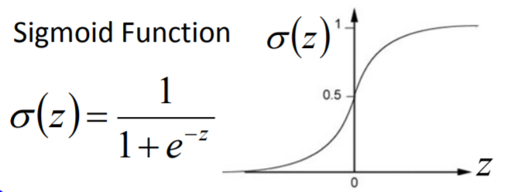










Use Deep Learning to solve nonlinear regression
Neural Network
Different connections leads to different network structures
$$w$$
$$+$$
$$σ(z)$$
$$b$$
$$+$$
$$σ(z)$$
$$+$$
$$σ(z)$$
$$+$$
$$σ(z)$$

Slide 15
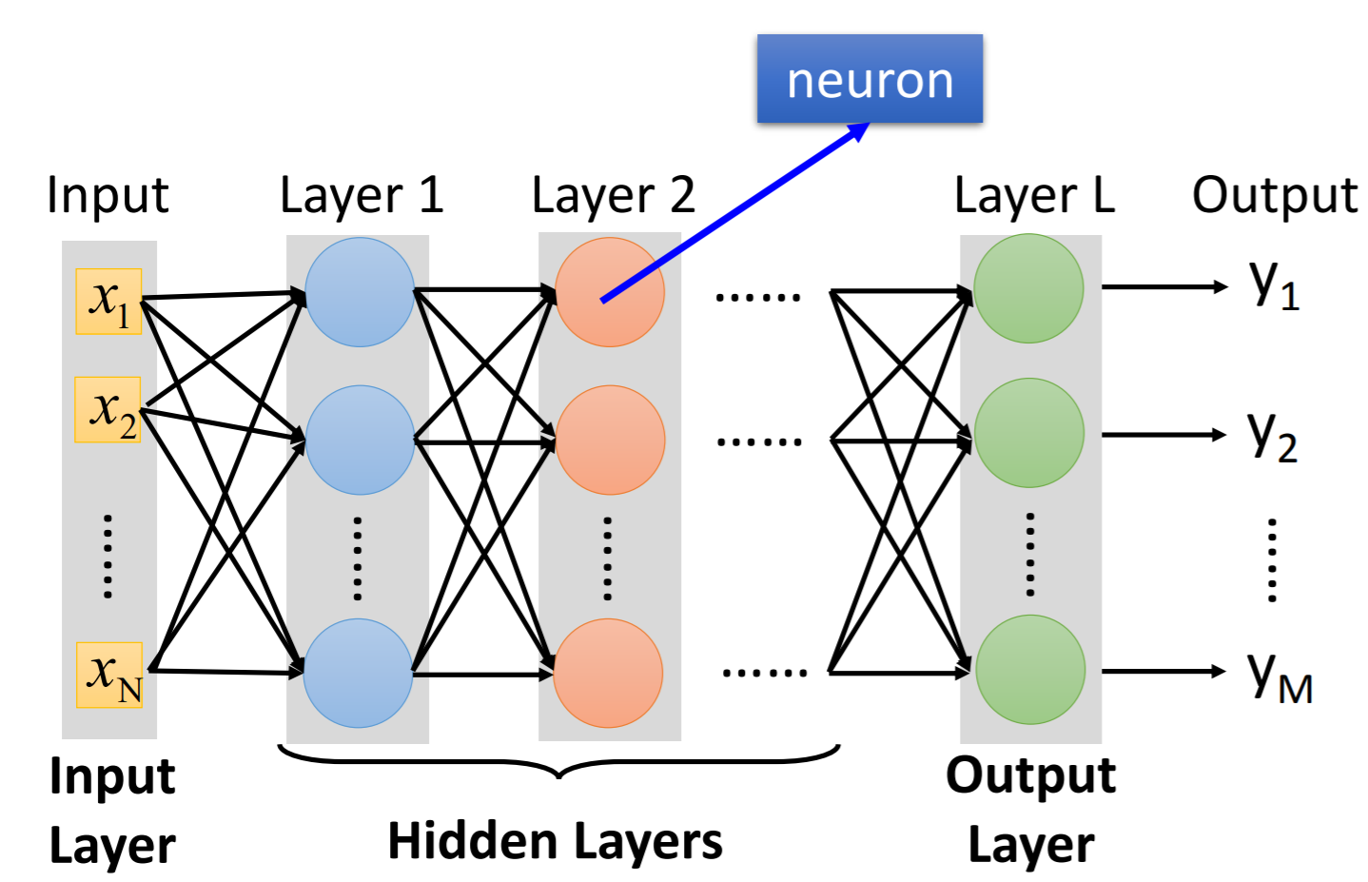
Use Deep Learning to solve nonlinear regression

Slide 16
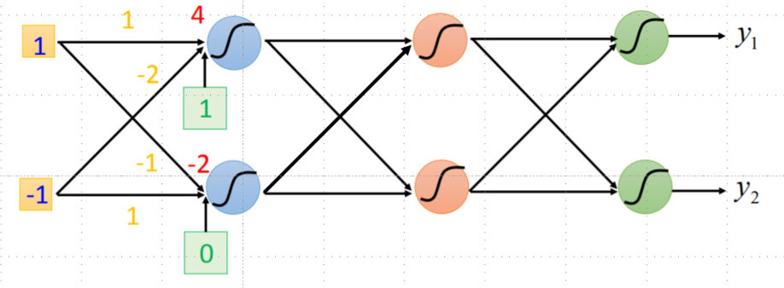
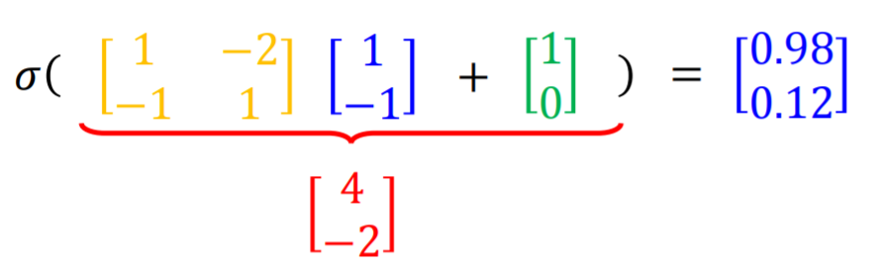
Use Deep Learning to solve nonlinear regression
0.98
Matrix Operation
0.12

Slide 17
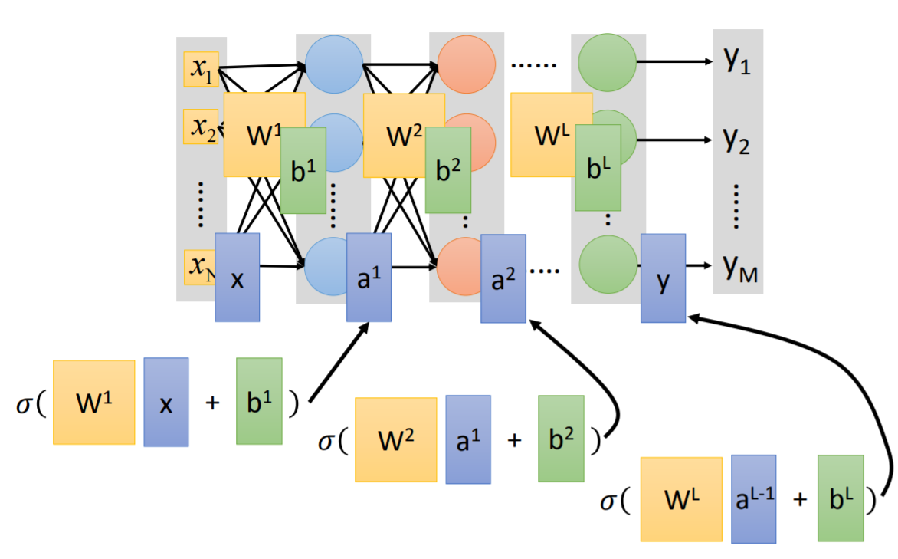
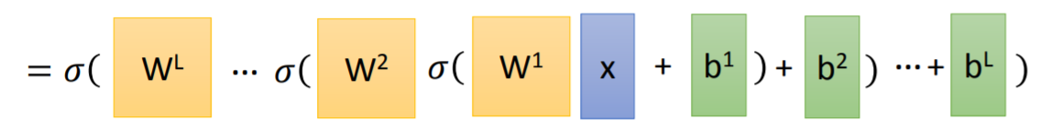
Use Deep Learning to solve nonlinear regression
Matrix Operation
How many layers? How many neurons for each layer?
Trial and Error + Intuition
Can we design the network structure?

Slide 18
Use Deep Learning to solve nonlinear regression
Step 1: define a set of function
Step2: goodness of function
Step3: pick the best function
Notes:
总结一下就是分三步: 所有可能的模型，定义什么样的模型是一个好模型， 想办法找到最好的那个

Slide 19
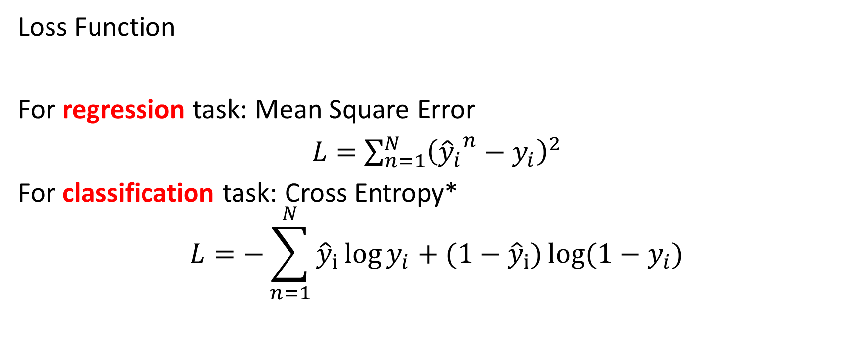
Use Deep Learning to solve nonlinear regression
Loss Function
For regression task: Mean Square Error
$L=$ $\sum_{n=1}^{N}{{\left({{\hat{y}}_{i}}^{n}−y_{i}\right)}^{2}}$
For classification task: Cross Entropy*
$$L=−\sum_{n=1}^{N}{{\hat{y}}_{i}\log{y_{i}}}+(1−{\hat{y}}_{i})\log{{(1−y}_{i}})$$

Slide 20
Use Deep Learning to solve nonlinear regression
Step 1: define a set of function
Step2: goodness of function
Step3: pick the best function
Notes:
总结一下就是分三步: 所有可能的模型，定义什么样的模型是一个好模型， 想办法找到最好的那个

Slide 21
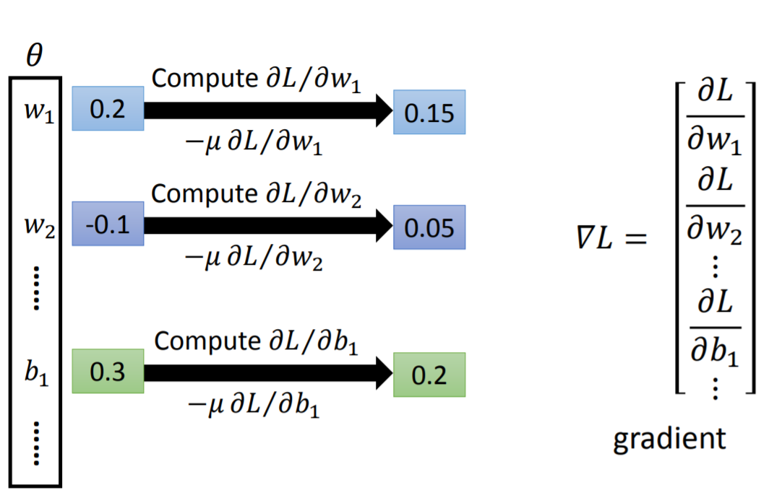
Use Deep Learning to solve nonlinear regression
Gradient Descent

Slide 22
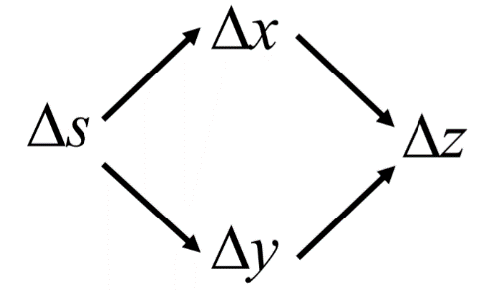
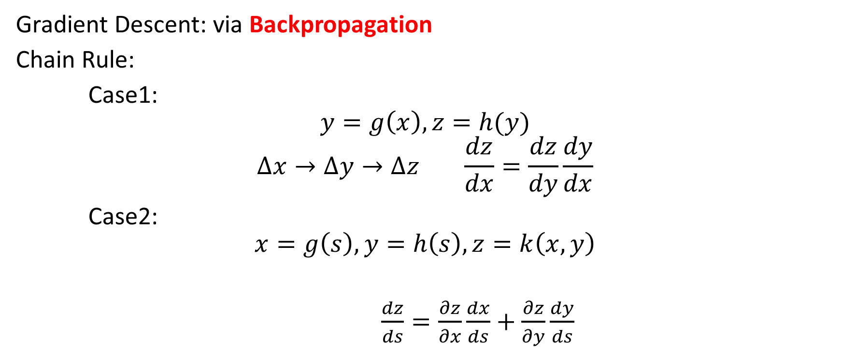
Use Deep Learning to solve nonlinear regression
Gradient Descent: via Backpropagation
Chain Rule:
Case1:
$$y=g\left(x\right), z=h(y)$$
$$∆x→∆y→∆z \frac{dz}{dx}=\frac{dz}{dy}\frac{dy}{dx}$$
Case2:
$$x=g\left(s\right), y=h\left(s\right),z=k\left(x, y\right)$$
$\frac{dz}{ds}=\frac{∂z}{∂x}\frac{dx}{ds}+\frac{∂z}{∂y}\frac{dy}{ds}$

Slide 23
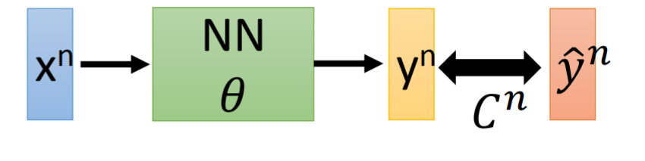








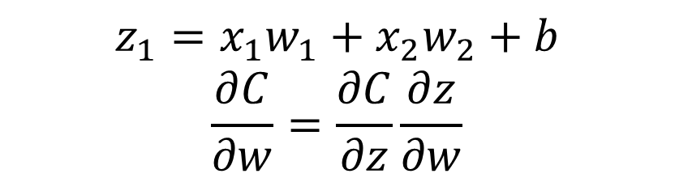

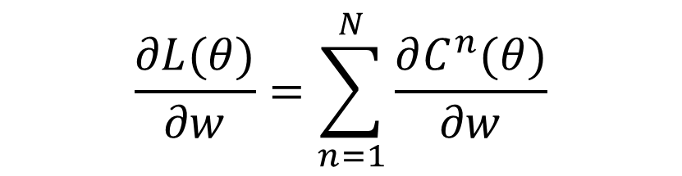




Use Deep Learning to solve nonlinear regression
Gradient Descent: via Backpropagation
$$L\left(θ\right)=\sum_{n=1}^{N}{C^{n}(θ)}$$
$$\frac{∂L(θ)}{∂w}=\sum_{n=1}^{N}{\frac{∂C^{n}(θ)}{∂w}}$$
$$w_{1}$$
$$z_{1}$$
$$x_{1}$$
$$σ(z_{1})$$
…
$$σ$$
$$y_{1}$$
$$+$$
$$z_{1}=x_{1}w_{1}+x_{2}w_{2}+b$$
$$\frac{∂C}{∂w}=\frac{∂C}{∂z}\frac{∂z}{∂w}$$
$$w_{2}$$
…
$$b$$
$$σ$$
$$x_{2}$$
$$y_{2}$$

Slide 24













Use Deep Learning to solve nonlinear regression
Gradient Descent: via Backpropagation
$$w_{1}$$
$$z_{1}$$
$$z_{1}=x_{1}w_{1}+x_{2}w_{2}+b$$
$$\frac{∂C}{∂w}=\frac{∂C}{∂z}\frac{∂z}{∂w}$$
$$\frac{∂z}{∂w_{1}}=x_{1}, \frac{∂z}{∂w_{2}}=x_{2}$$
$$x_{1}$$
$$σ(z_{1})$$
…
$$σ$$
$$y_{1}$$
$$+$$
$$w_{2}$$
…
$$b$$
$$σ$$
$$x_{2}$$
$$y_{2}$$

Slide 25
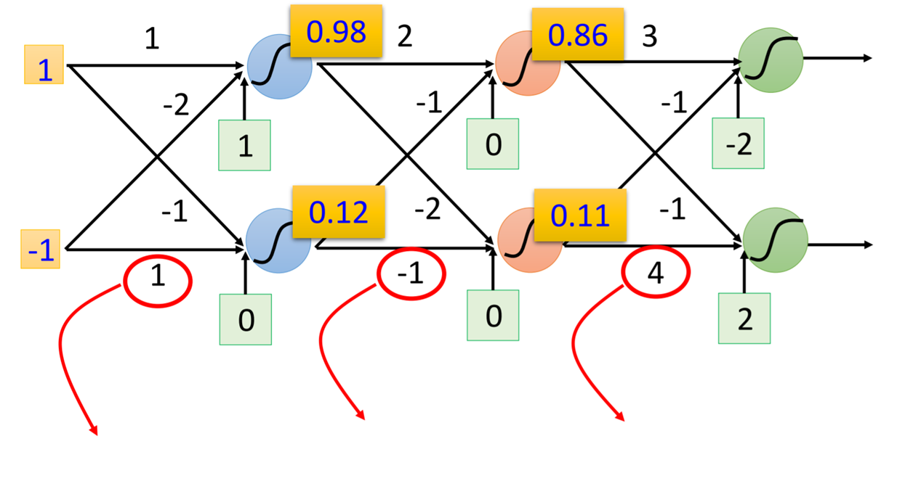
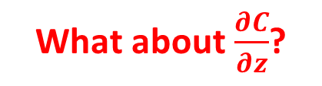




Use Deep Learning to solve nonlinear regression
What about $\frac{∂C}{∂z}$?
Compute $∂z/∂w$ for all parameters
$$\frac{∂z}{∂w}=−1$$
$$\frac{∂z}{∂w}=0.12$$
$$\frac{∂z}{∂w}=0.11$$

Slide 26





















Use Deep Learning to solve nonlinear regression
Compute $∂C/∂z$ for all activation function inputs z
Recap: $z_{1}=x_{1}w_{1}+x_{2}w_{2}+b$
$$\frac{∂C}{∂w}=\frac{∂C}{∂z}\frac{∂z}{∂w}$$
$$\frac{∂C}{∂z}=\frac{∂C}{∂z}\frac{∂a}{∂z}$$
$$\frac{∂C}{∂a}=\frac{∂C}{∂z′}\frac{∂z′}{∂a}+\frac{∂C}{∂z′′}\frac{∂z′′}{∂a}$$
$$w_{1}$$
$$z_{1}$$
$$a$$
$$σ(z_{1})$$
$$w_{3}$$
$$z′$$
$$σ$$
$$x_{1}$$
$$+$$
$$+$$
$$w_{2}$$
$$w_{4}$$
$$b$$
$$x_{2}$$
$$z′′$$
$$σ$$
$$+$$
$$w_{3}$$
$$w_{4}$$

Slide 27
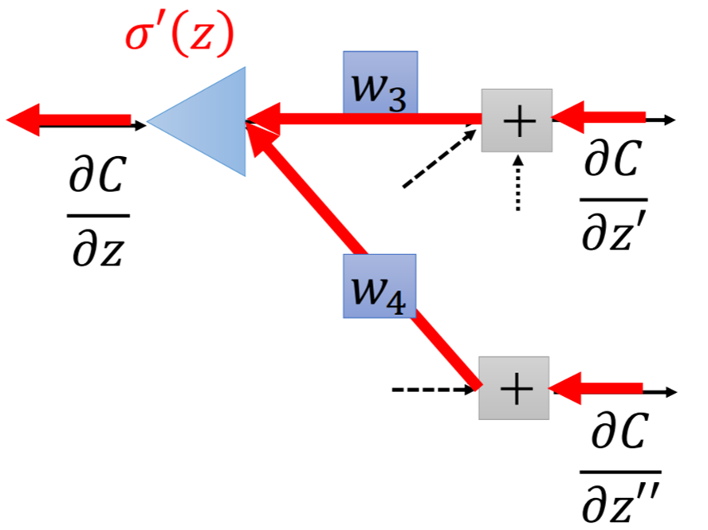
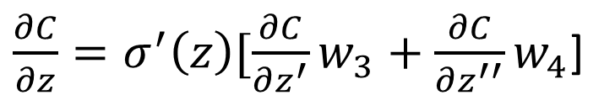

Use Deep Learning to solve nonlinear regression
Compute $∂C/∂z$ for all activation function inputs z
$$w_{1}$$
$$z_{1}$$
$$a$$
$$σ(z_{1})$$
$$w_{3}$$
$$z′$$
$$σ$$
$$x_{1}$$
$$+$$
$$+$$
$\frac{∂C}{∂z}=σ^{′}\left(z\right)[\frac{∂C}{∂z^{′}}w_{3}+\frac{∂C}{∂z^{′′}}w_{4}$]
$$w_{2}$$
$$w_{4}$$
$$b$$
$$x_{2}$$
$$z′′$$
$$σ$$
$$+$$

Slide 28
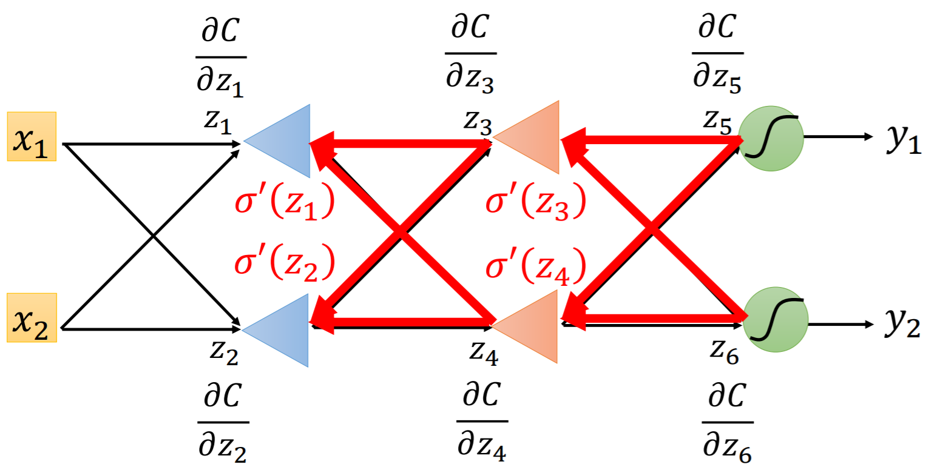

Use Deep Learning to solve nonlinear regression
Compute $∂C/∂z$ from the output layer

Slide 29
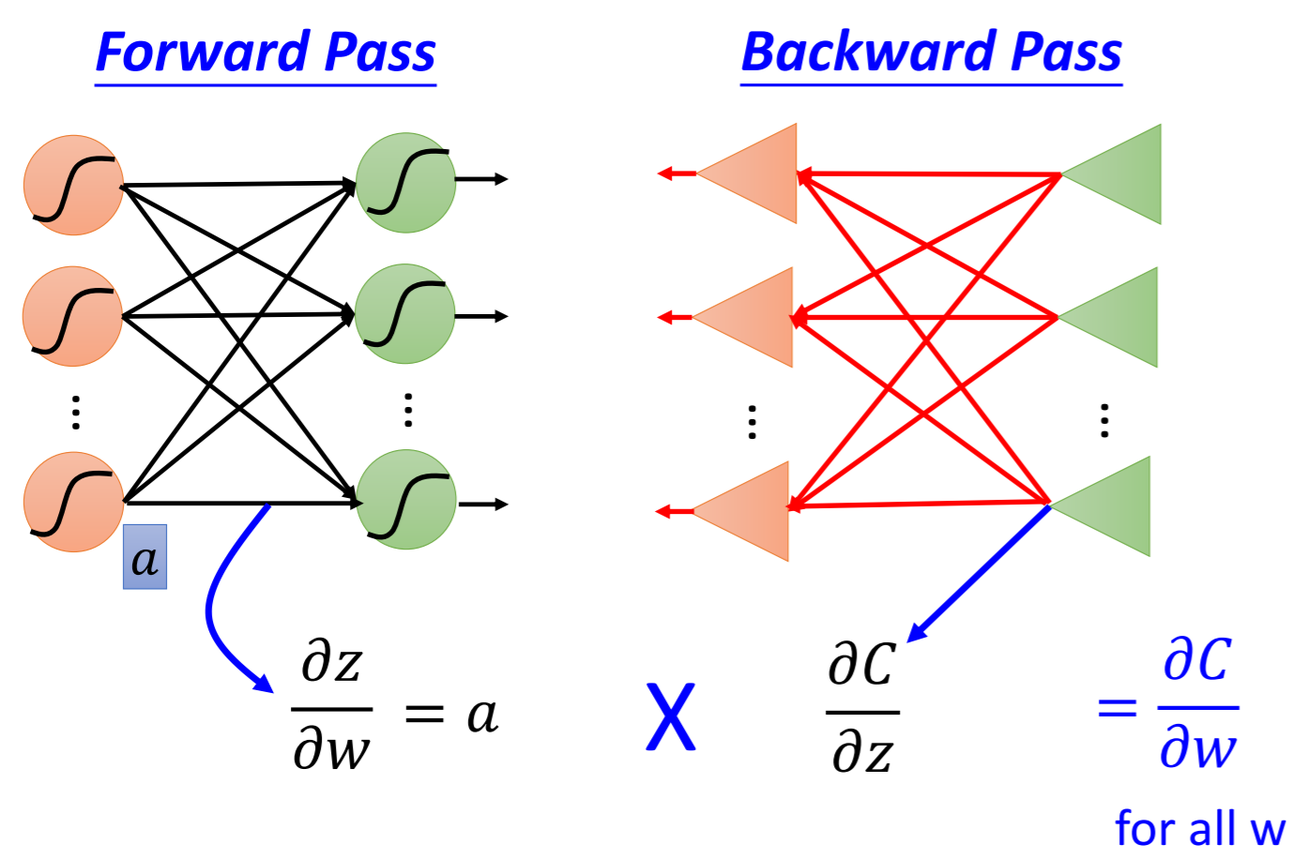
Use Deep Learning to solve nonlinear regression
Backpropagation is done!

Slide 30
Know more about machine learning techniques, see you next time!
Python: https://www.coursera.org/specializations/python-3-programming
Tensorflow: https://tensorflow.google.cn/
Pytorch: https://pytorch.org/
Machine Learning: https://www.coursera.org/learn/machine-learning
Reinforcement Learning: http://rail.eecs.berkeley.edu/deeprlcourse/;
https://www.openai.com/; https://www.deepmind.com/
Chinese Course: https://www.youtube.com/channel/UC2ggjtuuWvxrHHHiaDH1dlQ
NLP: http://web.stanford.edu/class/cs224n/
CV: http://cs231n.stanford.edu/

Slide 31
Thanks For Listening!

